Slide 1
The association of C-reactive protein and incidence of stroke in African American population of Jackson Heart Study
Jun Pan, Brian Liles, Ritesh Lohiya
CUNY MSDS Fall 2019

Slide 2
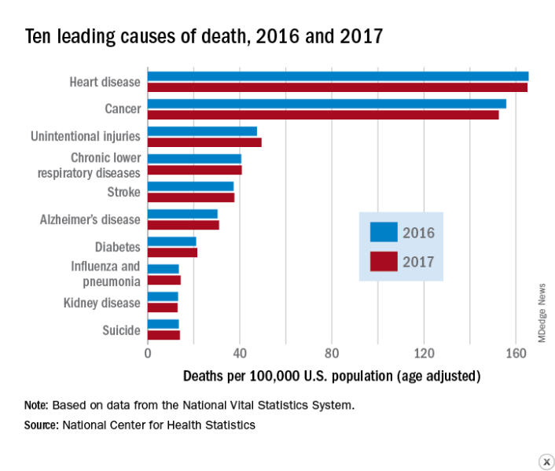
Stroke among top 10 leading causes of death

Slide 3
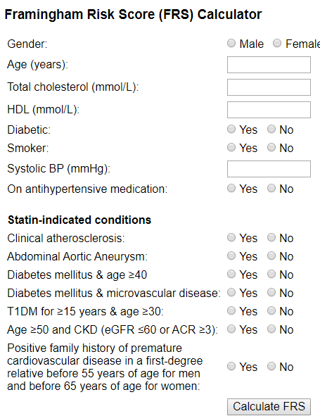
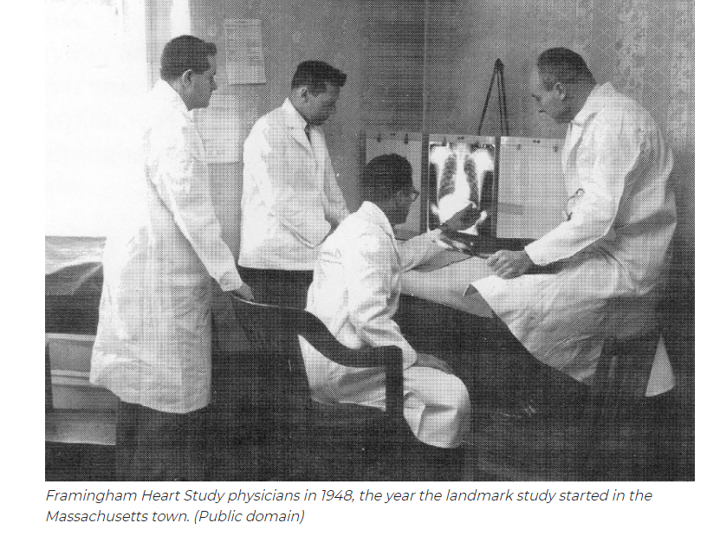
Risk Scores fit for CHD, but not for stroke

Slide 4


Framingham ARIC JHS
1987
1997

Slide 5
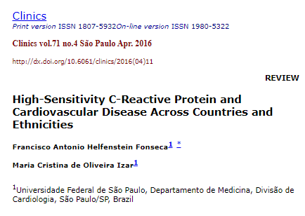
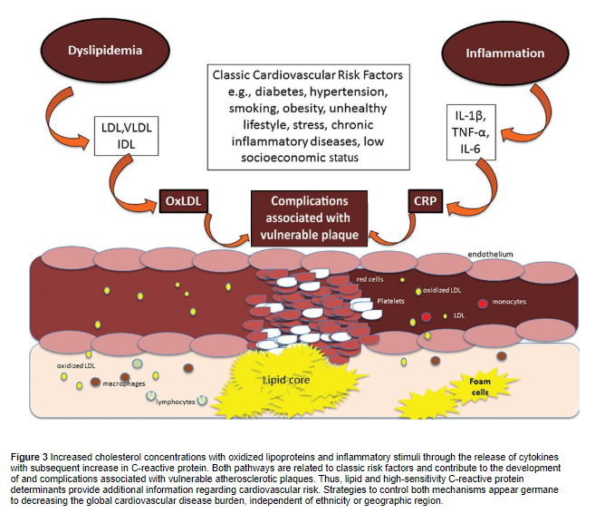

Slide 6
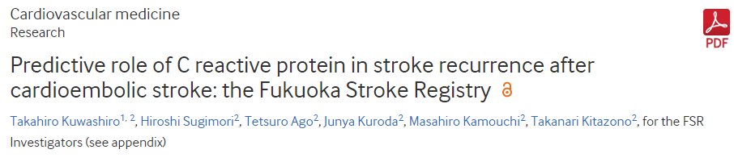
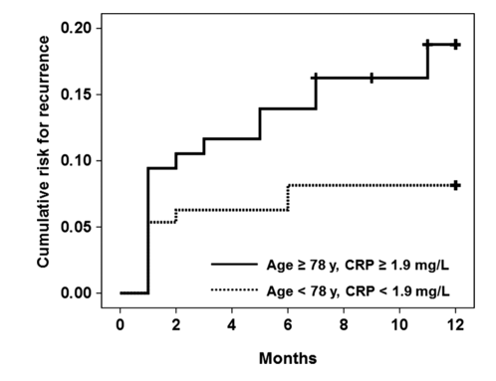

Slide 7
DATA EXPLORATION
In this section, we are going to using "incevtstroke.csv" file, with 8 columns. This file includes stroke incidence information. "analysiswide.csv" includes V1, V2, V3 information with 628 columns. For "incevtstroke.csv" file, we need to dealing with missing stroke status information, which means deleting rows will be implement. For "analysiswide.csv", there are so many columns complete missing information. We are going to delete those columns.
We found 139 patients with missing information whether had stroke incidence or not. So we have to exclude those participants for this project. Finally, we got 79 patients with stroke and 2435 non-stroke case in this project. p<0.05 was considered as statistical significance.

Slide 8
Overview Difference Between Stroke and Non-stroke participants I
 | Stroke | Non-stroke
Age (yr, mean±sd) | 70.67 ± 11.04 | 61.87± 11.66 ***
% of Male | 41.77 | 37.17
% of Current Smoker | 19.00 | 11.17
BMI | 31.55±7.48 | 32.29±7.22
% of BP medication | 88.46 | 73.99 **
% of Diabetes Medication | 35.44 | 22.27**
% of Statin Medication | 50.63 | 37.62*
Systolic BP (mmHg) | 134.01±24.74 | 127.14±18.59*
Diastolic BP (mmHg) | 72.50±14.31 | 75.04±10.84
% of Hypertension | 92.41 | 72.73***
Ankle Branchial Index | 1.17±0.18 | 1.25±0.14***
Fasting plasma glucose (mg/dL) | 117.15±55.31 | 105.10±31.60
HbA1C (%) | 6.64±1.50 | 6.18±1.22
Fasting insulin(ui/ml) | 11.88±7.59 | 14.22±11.27
* p<0.05, ** p<0.01, *** p<0.001

Slide 9
Overview Difference Between Stroke and Non-stroke participants II
 | Stroke | Non-stroke
HOMA_B | 188.32±105.74 | 226.70±128.46*
HOMA_IR | 2.61±2.14 | 3.02±2.13
% Diabetes | 50.63 | 30.60*
Fasting LDL (mg/dL) | 127.65±46.63 | 119.57±35.67*
Fasting HDL (mg/dL) | 56.71±15.80 | 57.58±15.82
Fasting Triglyceride (mg/dL) | 120.59±75.28 | 98.63±56.35*
Fasting Total Cholesterol (mg/dL) | 208.18±53.35 | 196.72±39.53
hsCRP (mg/dL) | 0.67±0.95 | 0.56±0.93
Serum e-selectin (ng/mL) | 45.50±21.72 | 43.51±19.82
Plasma p-selectin (ng/mL) | 36.09±12.15 | 33.54±11.24
Serum cortisol (ug/dL) | 10.66±3.68 | 9.52±3.90**
eGFR mdrd(ml/min/1.73m2) | 74.64±25.52 | 85.94±23.81***
eGFRckdepi(ml/min/1.73m2) | 72.43±24.67 | 86.59±22.91***
* p<0.05, ** p<0.01, *** p<0.001

Slide 10
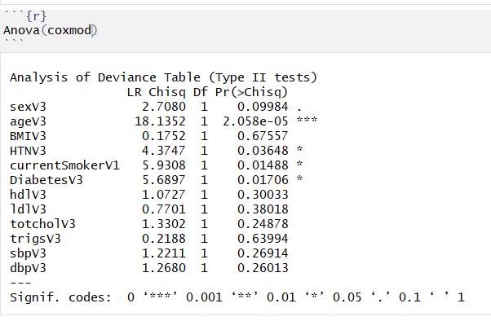
Anova of Cox Model

Slide 11
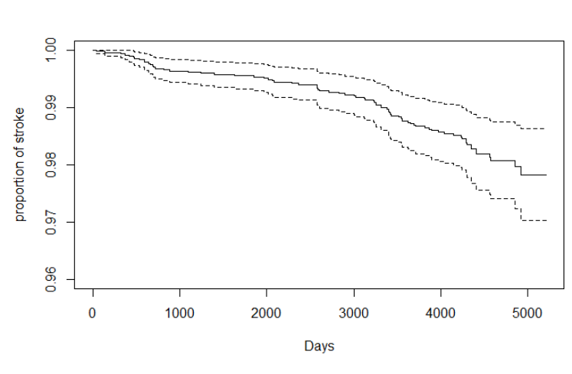
Survive Curve of Cox Model with 95% CI

Slide 12
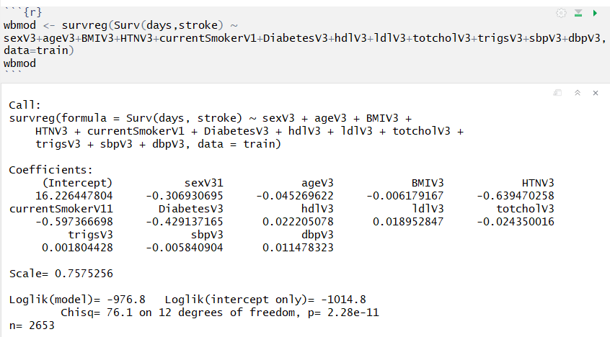
Weibull Model

Slide 13
To Do List
Try to build more models to evaluate the association of CRP and stroke.
2. Test the models using AUC, R² and other relate
Test the models using AUC, R² and other related methods.
Try to find more inflammation related risk factors.
Review more literatures and try to establish a theory based on our

